Slide 1
Attributes of different charging methods

Slide 2
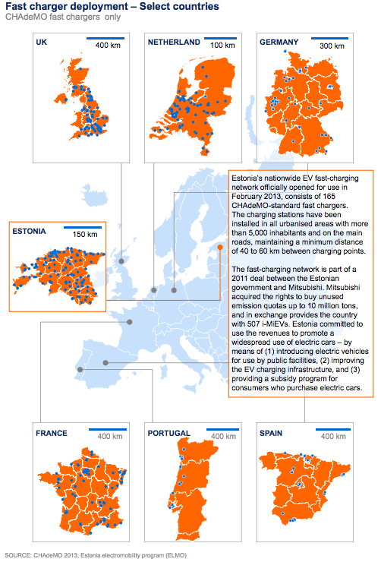



Slide 3









Slide 4






Slide 5
